Slide 1

Pala and Sena Dynasties in Ancient Bengal- pluralism, Tolerance, culture
Aynul Islam
Associate Professor

Slide 2
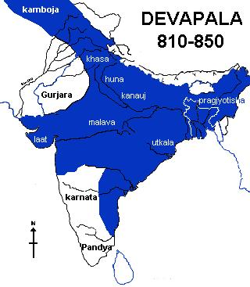
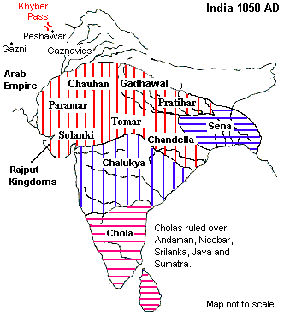

Slide 3
400 Years of pala empire: 756 AD-1161 AD
The Pala dynasty ruled the regions of Bengal and Bihar for about 400 years, from the 8th century until the end of the 11th century, with about 20 leaders on the throne during the period.

Slide 4
Maurya Dynasty (321 BC–185 BC)
Foremost Rulers: Chandragupta Maurya, Ashoka Vardhana
Gupta Empire (240 AD–550 AD )
Foremost Rulers: Sri-Gupta, Chandra Gupta-1, Samudra GuptaGauda
Gaur Kingdom (590 AD–637 AD)
Foremost Ruler: Shashanka
Pala Empire (756 AD-1161 AD)
Foremost Rulers: Gopala, Dharmapala, Devapala, Mahipala-1, Rampala
Sena Dynasty: (1070 AD-1229 AD)
Foremost Ruler: Hemantasen, Vijayasen, Ballalsen, Lakshmansen

Slide 5

The region that is now north-eastern India and Bangladesh had been in a state of anarchy for about a century following the fall of the Post Gupta dynasty.
After the death of Sasanka there was a complete chaos and confusion in Bengal.
This near anarchy that prevailed Bengal came to be known by the term ‘matsyanyaya’.
Bengal was relieved of the prevailing anarchy with the election of Gopala as the king of Bengal in 750 AD.

Slide 6
the founder and first ruler of the Pala Empire
It wasn't until one feudal lord named Gopala managed to gain the support of other leaders that stability started to emerge.
Through a democratic process, he took control of the region called Varendra, made up of north-western Bangladesh, West Bengal, and the Indian area of Bihar.

Slide 7
Dharmapala: the dynasty's second ruler
He was real founder of Pala Dynasty because he greatly expanded the boundaries of the empire, and made the Palas a dominant power in the northern and eastern India.
He was a great patron of Buddism.
He revived the Nalanda university and founded the Vikramshila university.
He built the great Vihara at Somapuri in Verendri and the Vihara in Paharpur.

Slide 8
PALA Contributions
The Pala Rulers were promoters of classical Indian philosophy, literature, painting and sculpture. They built grand temples and monasteries, including the Somapura Mahavihara, and patronised the great universities of Nalanda and Vikramashila. The Proto-Bengali language developed under the Pala rule. The empire enjoyed relations with the Srivijaya Empire, the Tibetan Empire and the Arab Abbasid Caliphate.

Slide 9
BUREAUCRACY AND ADMINISTRATION
The administration of the Pala dynasty was involved in all aspects of the bureaucracy from the central government all the way down to local villages.
Tax was collected more efficiently than ever before and this income was used to fund everything from ferry jetties in rivers to large ports on the coastline.
Even management of the forests and the markets was under the control of the kings.

Slide 10
religious tolerance
Interestingly, though, most of the subjects in the area controlled by the Pala Empire were actually Hindus. The Pala rulers followed an approach of religious tolerance, granting land for Hindu temples and allowing Hindu Brahmins to hold high official posts in the Pala court. This allowed for a peaceful exchange of ideas between the faiths and is a large factor in why Hindu Tantrism made its way into Buddhism, giving rise to the Vajrayana philosophy.

Slide 11
forging relationships with different cultures to promote new trade routes
The Pala kings are also considered to have been diplomats, forging relationships with different cultures to promote new trade routes. The empire enjoyed good connections with Southeast Asia and the Middle East – but it was more than just trade that was shared. Cultural ideas were also transferred and there's evidence of Islam appearing in Bengal during this time, while mathematical and astronomical achievements of the Indian civilisation were absorbed in places like Iraq. In Southeast Asia, the most prominent of this exchange of ideas can be seen in the architecture of temples that were based on the design at Paharpur.

Slide 12
The Sena Dynasty (1097 AD-1204 AD)
Vijoy Sena founded the Sena empire.
The Senas held sway over Bengal for more than a century (c1097-1223 AD) in which five generations of kings
But it must be noted that the invasion of Bakhtiyar Khalji put an end to Sena rule in parts of western and northern Bengal (in 1204 AD) and Luxmanasena had to fall back on his possessions in southeastern Bengal where, after him, his two sons ruled for some time.
The period saw the development of Sanskrit literature in Bengal.

Slide 13
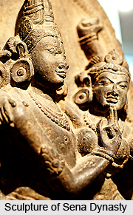
Sena dynasty
It was partly under the direct patronage of the Sena kings and partly due the environment created by them that literary activities in Sanskrit are distinctly visible in this period.
Another arena of artistic achievements in the period was in the field of sculptural art. The Bengal school of sculptural art reached its high-water mark in the Sena period…

Slide 14
